Slide 1
Alarm Sound Tutorial

Slide 2
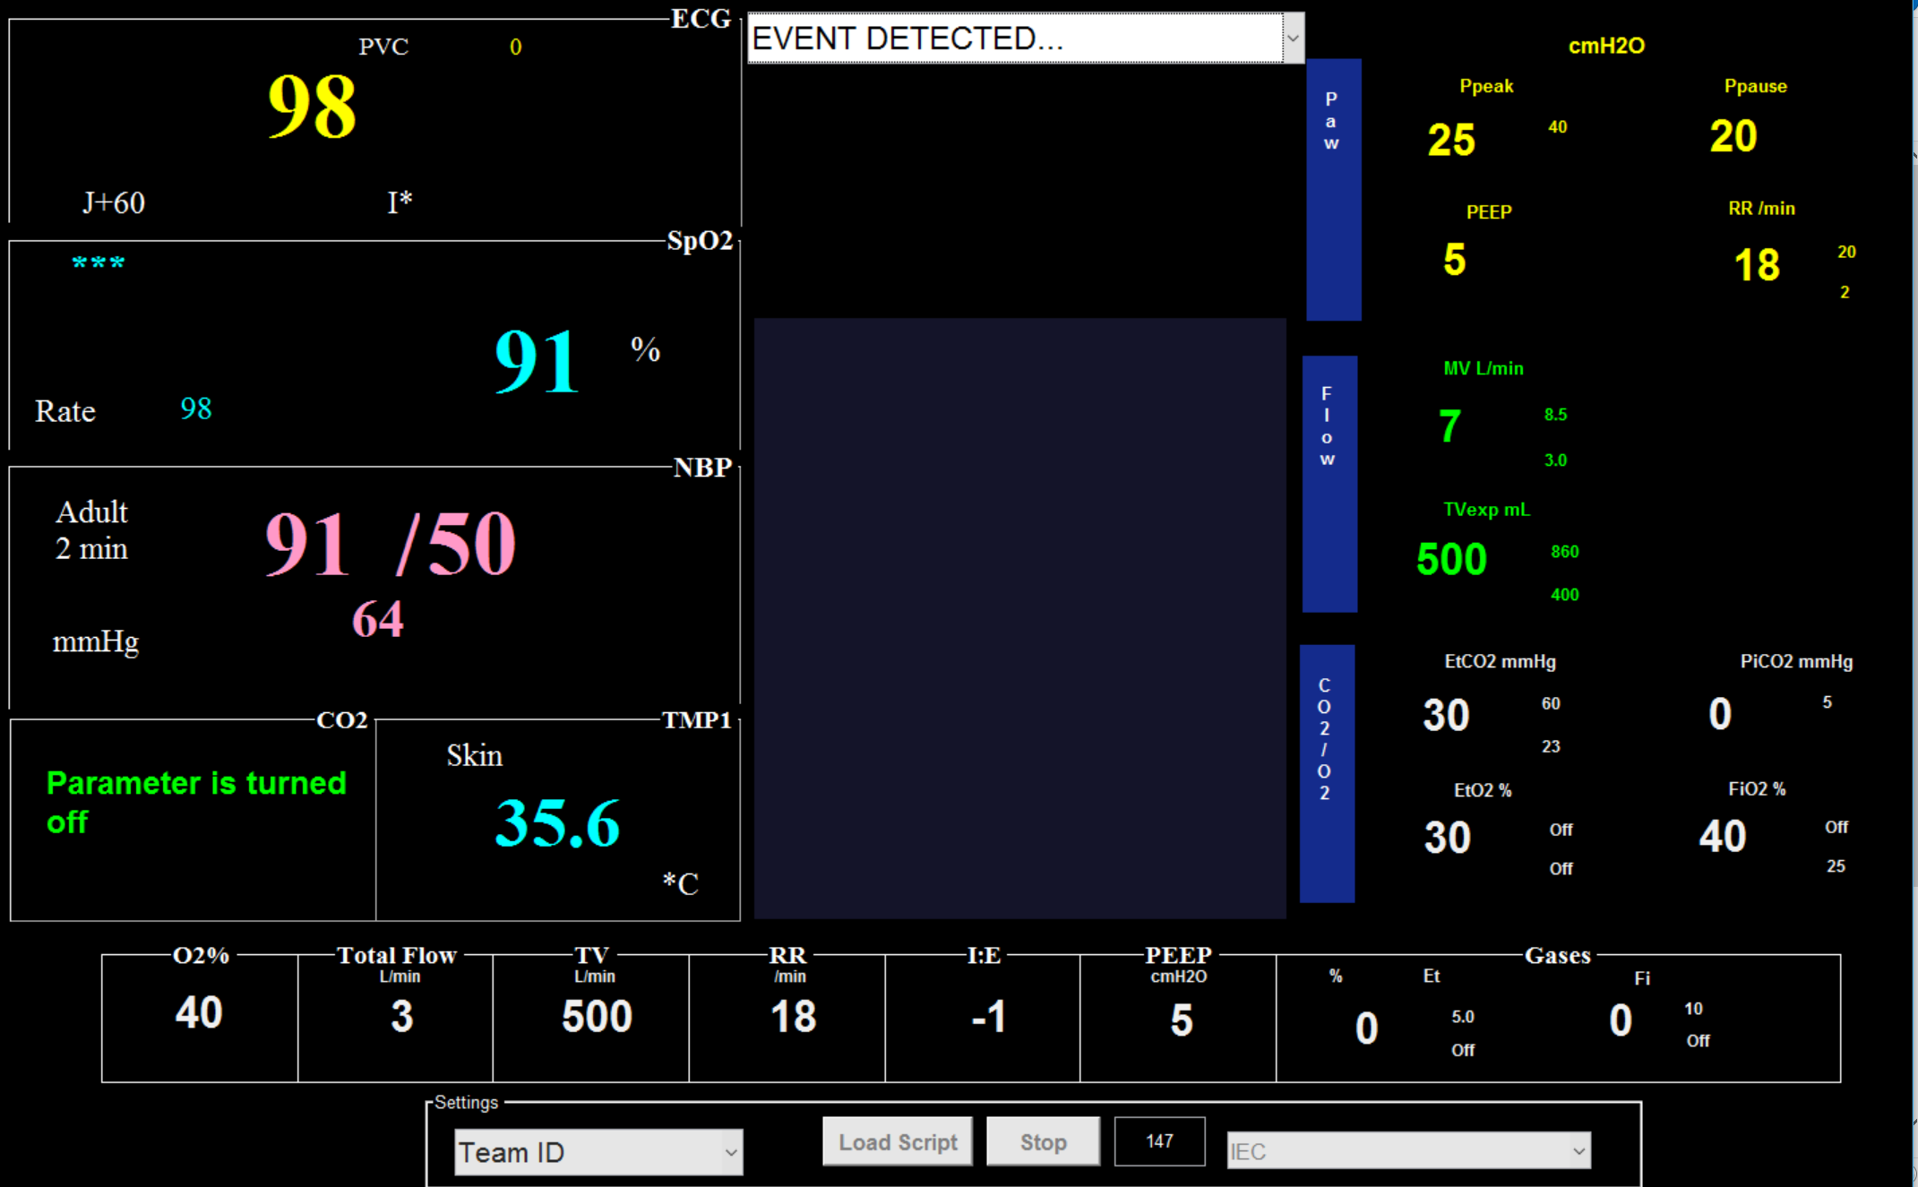
Instructions
Thank you for choosing to participate in this study! Please remember that your participation is optional, and that you may discontinue your participation at any time with no consequence to you.
You will be taking care of a few simulated patients in the intensive care unit (ICU).
When you hear an alarm sound, please go to the monitor which is sounding and tap on the bar at the top (select “event detected”)

Slide 3
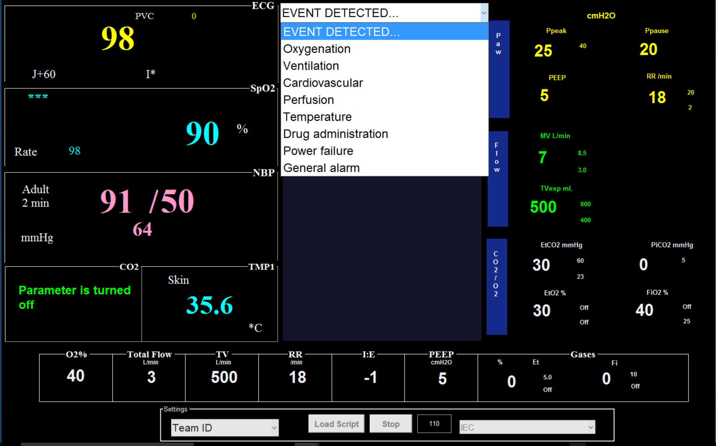
Instructions
Once you tap on the bar, the following drop down menu will appear:
Please select the reason that the alarm is sounding (i.e., if the heart rate is low, and the corresponding alarm is sounding, you would select “cardiovascular”).

Slide 4
Alarm Sounds
The following slides will highlight which sounds correspond with which abnormal values.
Possible alarms include: Oxygenation, Ventilation, Cardiovascular, Perfusion, Temperature, Drug administration, Power failure, and General alarm
Please review each slide and listen to each alarm sound.
We will also list “parameters” for some of the alarms. If the patient has a vital sign or value outside of the set parameters listed, an alarm will sound.

Slide 5
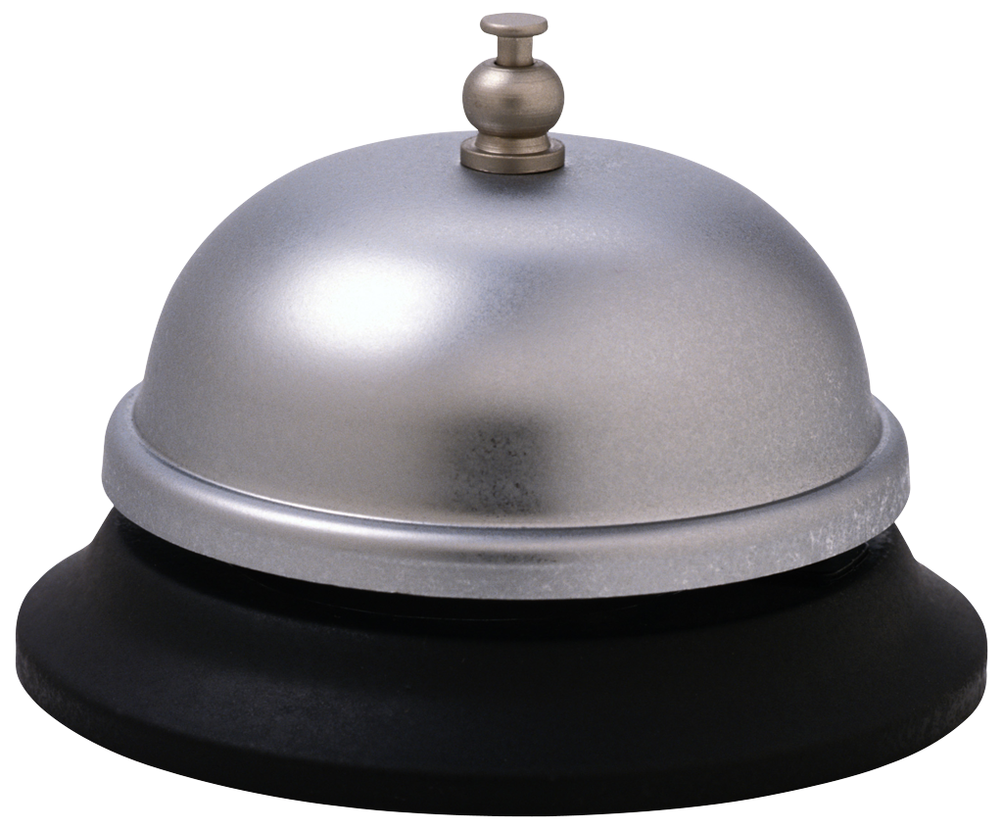
Alarm Sounds: Cardiovascular
If there is an abnormal heart rate (HR) or blood pressure (BP), this alarm will sound:
Parameters for your ICU patients are set to:
HR 60-100 bpm
Systolic BP 90-140 mmHg
Diastolic BP 40-90 mmHg
← Click here to listen

Slide 6
Alarm Sounds: Oxygen
If there is an abnormal oxygen saturation, this alarm will sound:
This parameter for your ICU patients is set to alarm if the oxygen saturation drops below 90%.
← Click here to listen

Slide 7
Alarm Sounds: Temperature
If there is an abnormal temperature, this alarm will sound:
This alarm will sound for your ICU patients if the temperature is below 35.5 degrees Celsius or above 37.5 degrees Celsius.
← Click here to listen

Slide 8
Alarm Sounds: Ventilation
If there are abnormal ventilation parameters, this alarm will sound:
This alarm will sound for your ICU patients if the end tidal carbon dioxide value is below 25 mmHg or above 60 mmHg.
← Click here to listen

Slide 9
Alarm Sounds: Drug Delivery
If there is a drug administration issue, this alarm will sound:
For example: an alarm will sound if there is an empty bag of medication or air in the tubing inside the medication administration pump
← Click here to listen

Slide 10
Alarm Sounds: Power Failure
If there is a power failure of a patient connected device, this alarm will sound:
← Click here to listen

Slide 11
Alarm Sounds: Perfusion
If a patient has an abnormality related to perfusion, this alarm will sound:
For example: a patient on extracorporeal membrane oxygenation (ECMO), cardiopulmonary bypass or dialysis machine with low flows
← Click here to listen

Slide 12
General Alarm
If any issue occurs that does not fall into one of the other categories, then this alarm will sound:
← Click here to listen

Slide 13
Patients
There are two patients in the ICU: Joe Smith and Sally Reeves
During your rounds, you come to find that Mr. Smith’s arterial line was accidentally pulled out earlier this morning. He is very edematous and your anesthesiology colleague tried replacing it earlier but was unsuccessful. The nurse asks you if you can stay with his two patients for a few minutes while they run to grab supplies (new kit, ultrasound, etc.) and a helper from the anesthesiology team to replace the arterial line. His noninvasive BP cuff is cycling more frequently in the meantime.

Slide 14
Joe Smith
Mr. Smith is a 30 year old otherwise healthy male who had a MVA against a pole 4 days ago. He was found outside of his car with burns along his posterior head, upper extremities, shoulders, and back. He was reported to have had agonal breathing and was intubated on scene. He has 19.5% TBSA burns.
He developed severe ARDS during his hospitalization and was placed on ECMO earlier this morning.
His arterial line was accidentally removed earlier today, and multiple replacement attempts so far have been unsuccessful.

Slide 15
Sally Reeves
Ms. Reeves is a 46 year old woman who was admitted 3 days ago after being found down in the street for an unknown amount of time; she was intubated at the scene (she has since been extubated and is doing well on nasal cannula). On arrival, she was found to have tense right deltoid and right lower extremity compartments. She was taken emergently to the OR for fasciotomy. She quickly developed rhabdomyolysis and acute renal failure. She’s being followed by the nephrology team, who have initiated dialysis.
She has been febrile to 38.5, and underwent wound debridement today. We have also started Vancomycin for empiric treatment of possible wound infection.

Slide 16
Thank you!
You will be taken into the simulation room now.
You are not being evaluated for your clinical performance or knowledge. No one will have access to results outside of the research team. Data will be de-identified and not linked to your name.
Once again, thank you for your participation in this study!

