Slide 1
An Immunological and Biomechanical Comparison of PEEK-Zeolite and PEEK Interbody Fusion Devices
Laboratory study comparing PEEK-zeolite and PEEK interbody fusion devices using a cervical ovine model
PEEK-zeolite is hypothesized to result in a reduced inflammatory response and to improve osseointegration
Each sheep received both a PEEK and PEEK-zeolite implant; the cervical level (C3-4 or C5-6) was randomly assigned to the implant
Immunological, biomechanical, and radiographic analyses were performed using data from two survival groups (12- and 26-weeks post implantation)

Slide 2
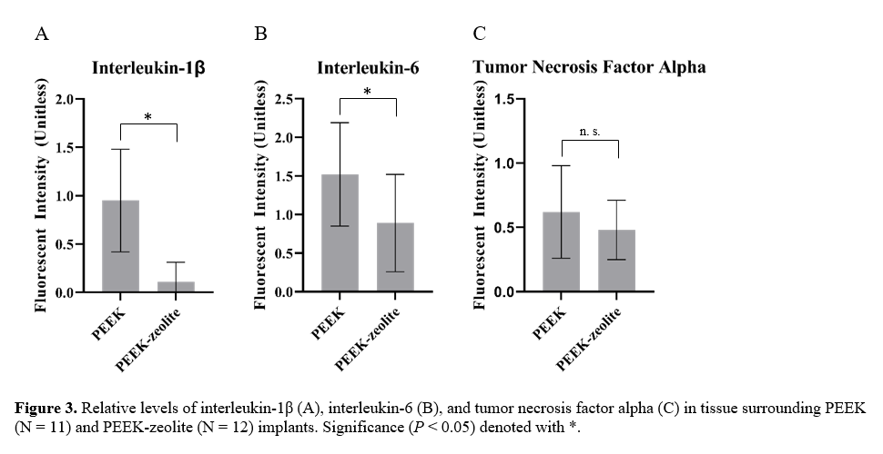
Immunological Findings
Compared to PEEK, PEEK-zeolite elicited a reduced pro-inflammatory response as measured by local tissue levels of interleukin-1β and interleukin-6

Slide 3
Biomechanical and Radiographic Findings
Range of motion in flexion-extension, lateral bending and axial torsion was similar for both PEEK-zeolite and PEEK implants at both 12 weeks and 26 weeks
Radiographic assessments of fusion, bone formation and bone implant interface were also similar at both timepoints
Conclusion
PEEK-zeolite is substantially equivalent to PEEK with regard to flexibility and fusion grade but elicits a decreased pro-inflammatory response

