Slide 1
Supplemental Digital Content p. 1
Standard Curve of Diluted Methadone Concentrate
Standard curve of diluted methadone concentrate (10 mg/ml). Diluted standards were 0.00, 0,31, 0.62, and 1.25 mg/ml. UV absorptions were recorded at 259 (blue triangles), 265 (red squares), and 292 nm (black circles). Linear regression lines are shown for 259 (blue short dotted line), 265 (red long dotted line), and 292 nm (solid line).
Regression statistics were
292 nm: A = 0.01 + 1.52 [M] r² = 0.9999
265 nm: A = 0.01 + 1.82 [M] r² = 0.9999
259 nm: A = 0.01 + 1.85 [M] r² = 0.9999
where A = absorbance, and [M] = methadone concentration (mg/ml)

Slide 2
Supplemental Digital Content p. 2
A
Ten methadone doses were prepared in the clinic in different amounts then subsequently measured by UV spectrometry. The plot shows the regression of the measured dose versus what was prepared.
The regression equation is (Measured) = (0.974 ±0.025)•(Prepared) – (1.9±2.3) r² = 0.995
with standard errors for the fitted parameters.
B
Plot of the ratio of the measured amount relative to what was prepared (measured/expected) versus what was prepared. The mean was 94.5% ±1.1% (±SE) and is shown as the solid line. The 95% confidence interval (±8.1%) is shown as the dotted lines.

Slide 3
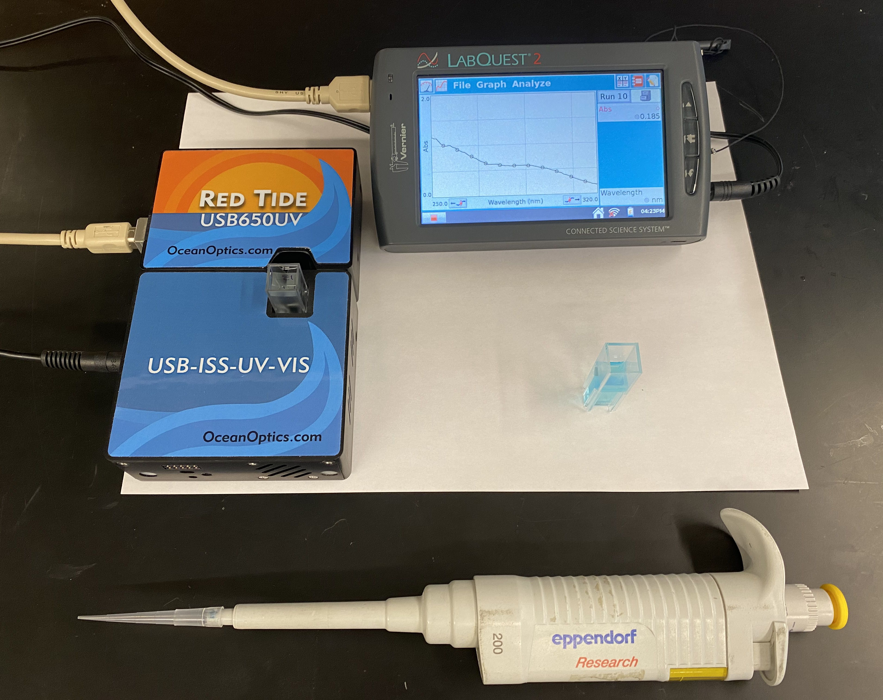
Supplemental Digital Content p. 3
Photograph of the Ocean Optics Red Tide USB650 UV-visible spectrometer (left) connected the Vernier LabQuest2 data acquisition controller (right). The two are connected by a USB cable.
An Eppendorf pipettor is shown at the bottom, and a BRAND™ disposable cuvette is shown (middle right) with diluted methadone in the cuvette.

