Slide 1

A 38-year old man with asymptomatic monocular nystagmus
Teaching NeuroImages
Neurology
Resident and Fellow Section
© 2016 American Academy of Neurology

Slide 2
Vignette
Complaining only of poor vision in his right eye for six years.
Right visual acuity was 20/200 due to traumatic aphakia (cataract extraction without intraocular lens) and 20/20 in the left eye.
An asymptomatic coarse, low frequency, pendular, vertical nystagmus was manifest of the right eye only.
Nguyen, et al
© 2016 American Academy of Neurology

Slide 3
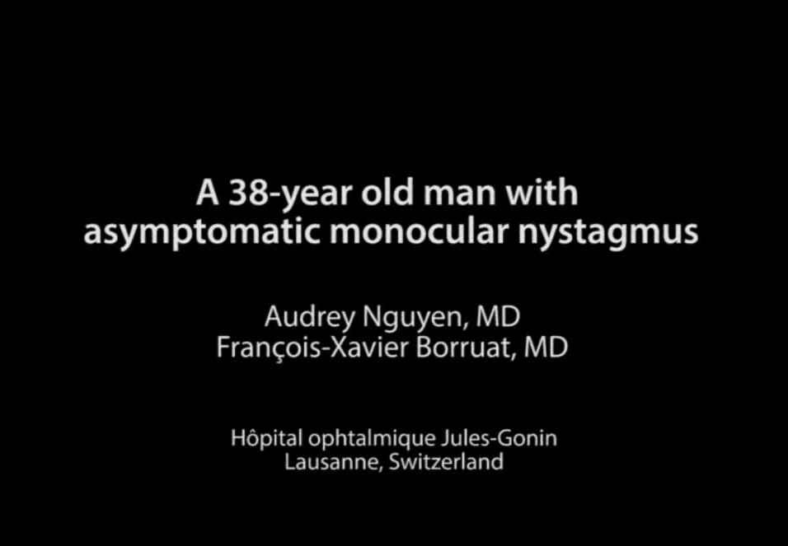
Video
Nguyen, et al
© 2016 American Academy of Neurology
Notes:
Video legend :
In primary gaze, the right eye was exotropic and exhibited a vertical pendular purely monocular nystagmus with a frequency of 1Hz and an amplitude of 8 to 10°. Despite the divergent strabismus, there was no limitation in eye movements, during which the nystagmus drastically dampened, but recovered immediately upon cessation.
Despite the obvious monocular vertical pendular nystagmus, the patient did not complain of vertical oscillopsia, due to the markedly decreased visual acuity of his right eye.

Slide 4
The Heimann-Bielschowsky phenomenon (HBP): a harmless monocular nystagmus
HBP is an asymptomatic monocular slow, pendular, mostly vertical nystagmus which can develop years after uniocular severe visual loss¹.
The pathogenesis of HBP is debated, but vertical fusion disruption due to monocular visual loss is hypothesized².
Recognizing HBP should prevent unnecessary investigations or treatments.
Nguyen, et al
© 2016 American Academy of Neurology
Notes:
References:
¹ Yee RD, Jelks GW, Baloh RW, et al. Uniocular nystagmus in monocular visual loss. Ophthalmology 1979; 86:511-522.
² Leigh RJ, Thurston SE, Tomsak RL, et al. Effect of monocular visual loss upon stability of gaze. Invest Ophthalmol Vis Sci 1989 ; 30:288-292.

