Slide 1
A 76-year-old man with word finding difficulties
Teaching NeuroImages
Neurology
Resident and Fellow Section
Kasischke et al.
© 2017American Academy of Neurology

Slide 2
VIGNETTE
A 76-year-old man presented with word finding difficulties and underwent a routine EEG.
Kasischke et al.
© 2017American Academy of Neurology

Slide 3
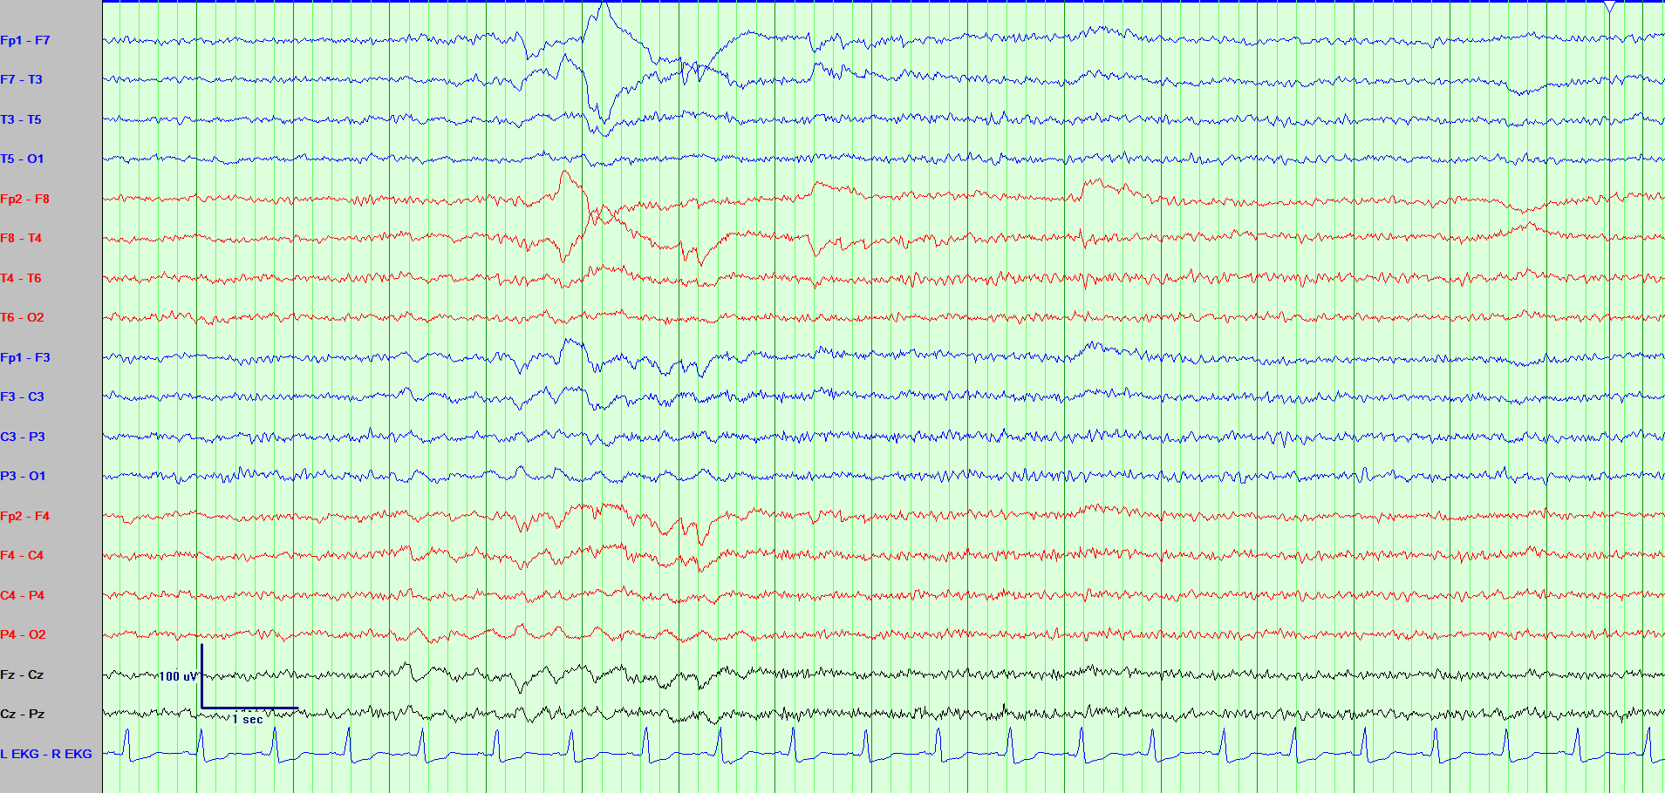
IMAGING/EEG
Kasischke et al.
© 2017American Academy of Neurology
Notes:
Figure 1. Two consecutive EEG pages in bilateral longitudinal (double banana) montage.
EEG sample with sleep spindles in normal stage N2 sleep. On the contiguous second page a burst of high-amplitude lateral eye movements with concurrent sawtooth waves is followed by rapid eye movements. This SOREMP could be misinterpreted as sharp wave complexes but in the clinical context indicates sleep deprivation.

Slide 4
Sleep-onset REM period (SOREMP) during routine EEG
Shortly after reaching stage N2 sleep, EEG showed brisk lateral eye movements with concurrent sawtooth waves (figure 1), indicating sleep-onset REM period (SOREMP).
Normal REM sleep is normally reached 90-120 min after sleep onset.
SOREMP is an abnormal EEG finding thought to be suggestive of narcolepsy. However, it may also be present in 3.9 % of the general population¹ and is normal in infants.
It is further associated with severe sleep deprivation, obstructive sleep apnea, and alcohol or medication (SSRI, SNRI, TCA, MAOI) withdrawal.
In the inpatient setting, it is usually caused by sleep deprivation².
Kasischke et al.
© 2017American Academy of Neurology
Notes:
REFERENCES
1. Sing M, Drake CL, Roth T. The Prevalence of multiple sleep-onset REM periods in a population-based sample. Sleep 2006; 29: 890-895.
2. Gangadhara S, Pizarro-Otero J, Bozorg A, Benbadis S. The significance of REM sleep on routine EEG. Neurodiagn. J. 2016; 56: 37-40.

