Slide 1
An 8-month-old with a tigroid MRI pattern
Teaching NeuroImages
Neurology
Resident and Fellow Section
© 2019 American Academy of Neurology

Slide 2
Vignette
An 8-month-old female presented with a 1-month history of developmental regression, irritability, and opisthotonic posturing.
A brain MRI revealed abnormal T2 hyperintensities in the periventricular and deep cerebral white matter, and in the peri-dentate cerebellar white matter.
Reduced galactocerebrosidase activity in leukocytes confirmed the diagnosis of Krabbe disease.
Andriescu et al.
© 2019 American Academy of Neurology

Slide 3
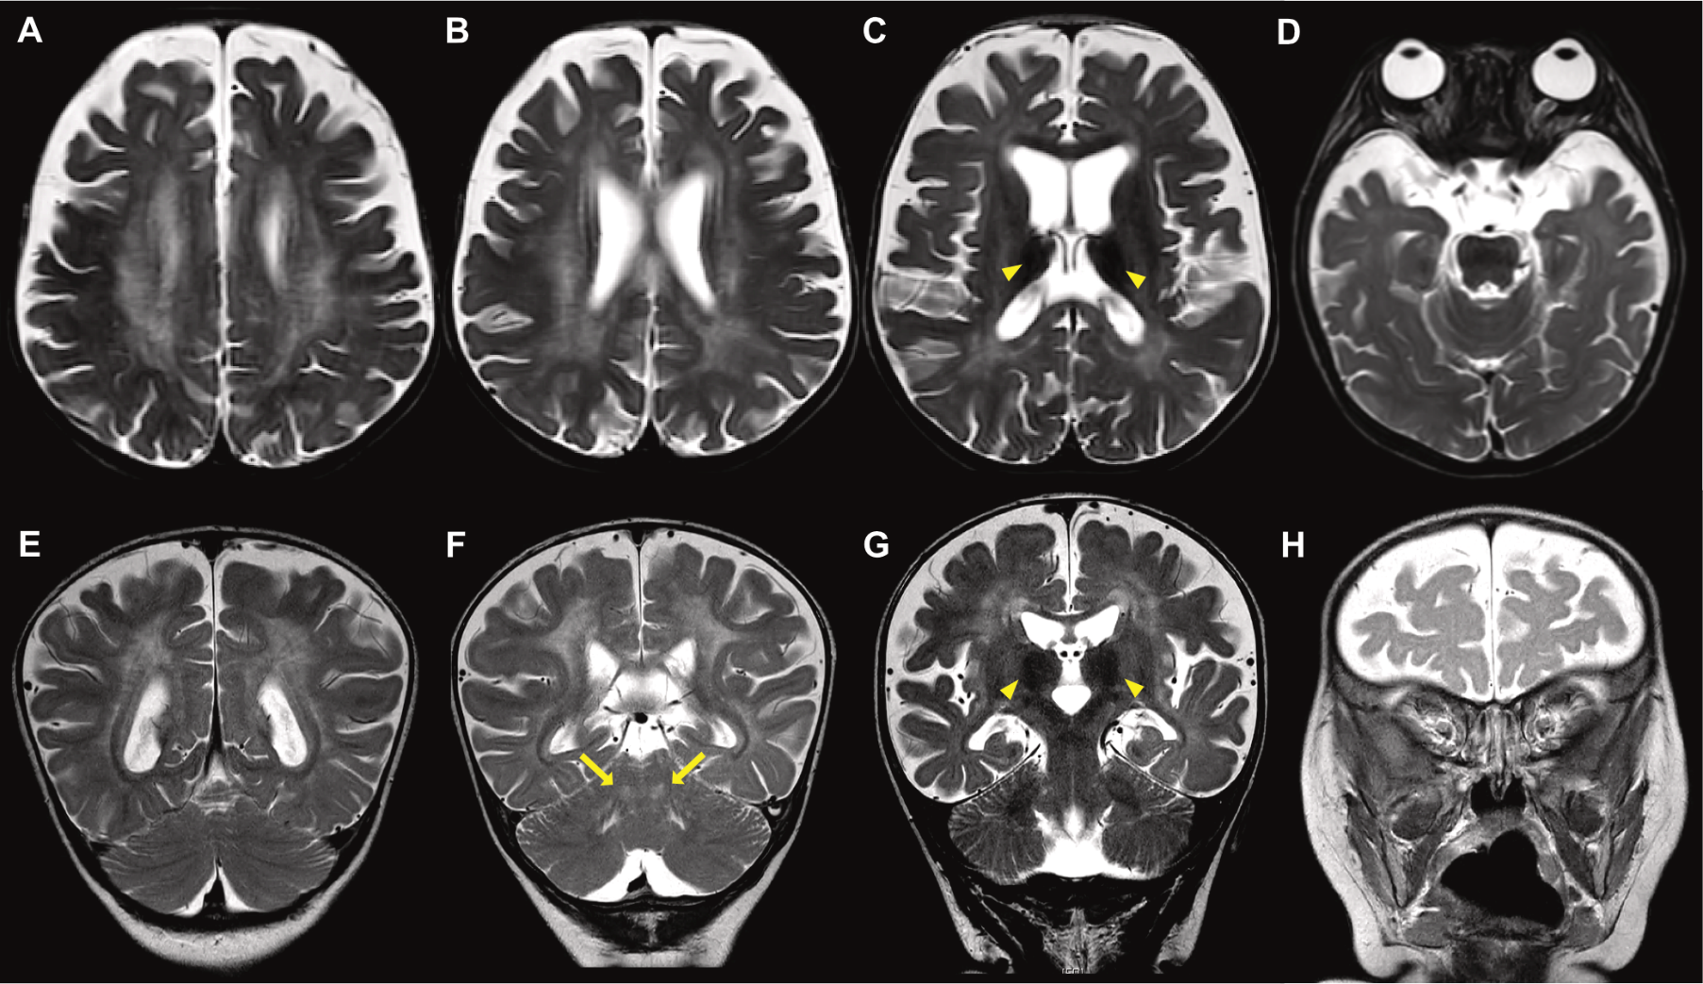
Imaging
Andriescu et al.
© 2019 American Academy of Neurology
Notes:
Figure. MRI images.
(A-D) Axial T2W views. (A) and (B) show bilateral symmetric hyperintensity of the periventricular and deep cerebral white matter with a tigroid appearance; (C) shows bilateral T2 thalamic hypointensities (arrowheads) and predominant parieto-occipital white matter involvement; (D) shows normal, non-enlarged optic nerves. (E-H) Coronal T2W views. (D) shows bilateral symmetric hyperintensity of the periventricular and deep cerebral white matter with a tigroid appearance; (E) shows peri-dentate cerebellar white matter hyperintensities (arrows); (F) shows bilateral T2 thalamic hypointensities (arrowheads); (H) shows normal, non-enlarged optic nerves.

Slide 4
Infantile-onset Krabbe disease with tigroid appearance of the white matter
Though typically characteristic of metachromatic leukodystrophy (MLD), the tigroid MRI pattern can also be seen in Pelizaeus-Merzbacher, and Krabbe disease.
Clinically, irritability, opisthotonus, developmental regression, and radiographically, early cerebellar involvement, decreased thalamic T2 signal, and if present, optic nerve enlargement, can help differentiate Krabbe disease from MLD.
Andriescu et al.
© 2019 American Academy of Neurology
Notes:
Duffner PK, Barczykowski A, Jalal K, et al. Early infantile Krabbe disease: results of the World-Wide Registry. Pediatr Neurol 2011;45:141.
Wenger DA. Krabbe disease. GeneReviews. www.ncbi.nlm.nih.gov/books/NBK1238/(Accessed on December 14, 2011).
Muthusamy K, Sudhakar SV, Thomas M, et al. Revisiting magnetic resonance imaging pattern of Krabbe disease- Lessons from an Indian cohort. J Clin Imgaing Sci 2019;9:25.

