Slide 1
Teaching NeuroImages
A 49-year-old man with acute left middle cerebral artery occlusion
Neurology®
Resident & Fellow Section
© 2020 American Academy of Neurology

Slide 2
Vignette
We describe the neuroimaging findings of a 49-year-old man presenting with left middle cerebral artery occlusion (admission NIHSS-score: 19) due to an underlying spontaneous carotid artery dissection.
The Patient was treated with intravenous thrombolysis and mechanical thrombectomy, achieving complete reperfusion.
Theodorou et al.
© 2020 American Academy of Neurology

Slide 3
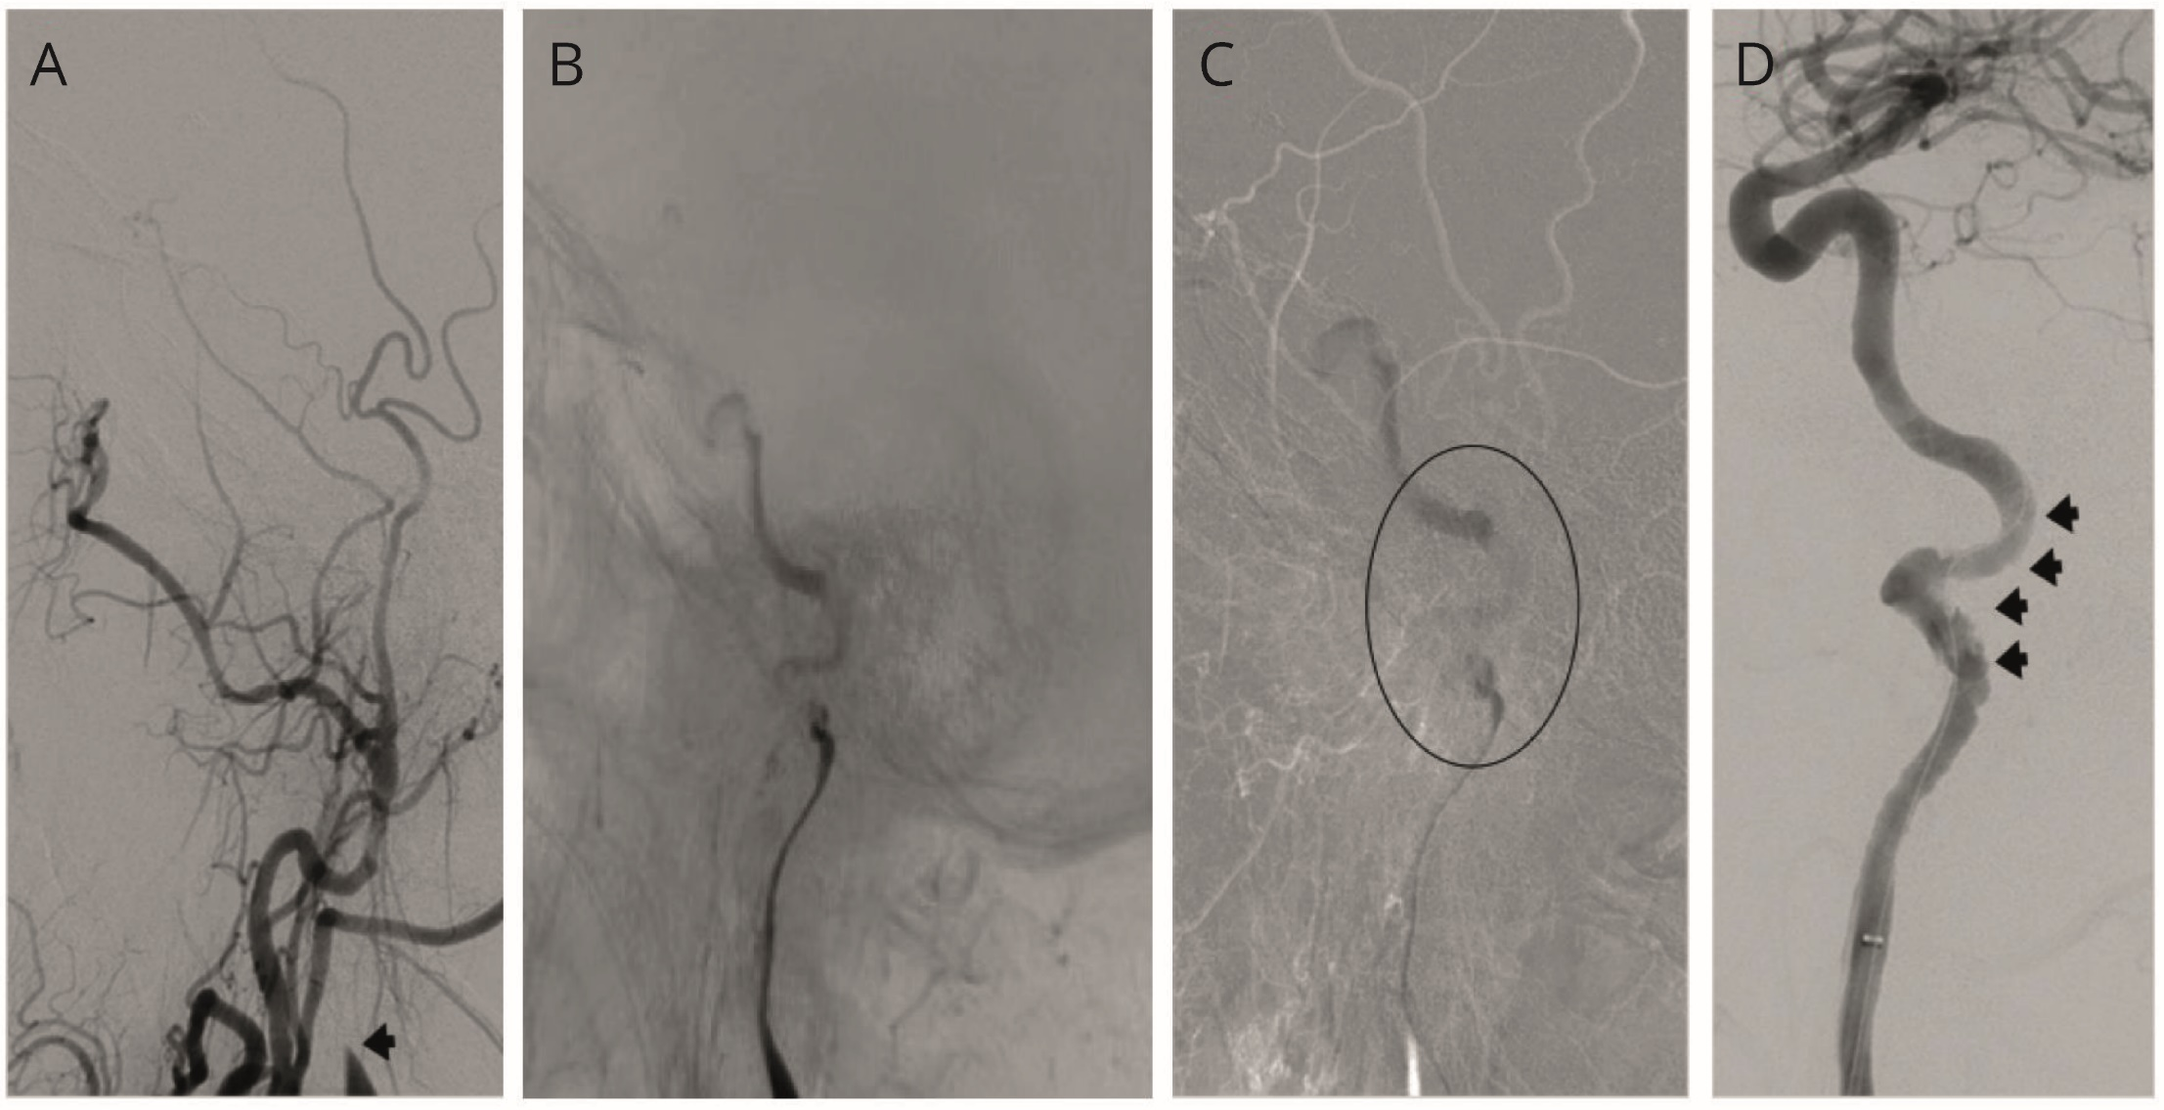
Image
Theodorou et al.
© 2020 American Academy of Neurology
Notes:
Figure 1
Diagnostic DSA revealing left cervical internal carotid artery occlusion due to underlying dissection with characteristic flame-shaped appearance (A).
DSA images during (B and C) and at the end of mechanical thrombectomy (Panel D) disclose extra- and intra-cranial ICA recanalization and mural dissection (D; black arrows).

Slide 4
Image
Theodorou et al.
© 2020 American Academy of Neurology
Notes:
Figure 2.
Hyperdense MCA–Sign in the left M1 segment (A; white arrows) on baseline brain-CT. Post-Thrombectomy DSA revealing complete reperfusion – [TICI-2B (B)]. Residual basal ganglia infarction depicted in follow-up brain MRI (C; red arrow).
Quantitative sensory tests showing impairment of cold and warm perception in the lower limbs (D and E) and corneal confocal microscopy revealing bilateral cornea verticillata (F).

Slide 5
An Uncommon Cause Of Carotid Artery Dissection: Fabry Disease
DSA pre- and post-thrombectomy, revealed occlusion of the left internal carotid artery and the underlying mural dissection.
Further diagnostic work-up excluded other stroke-etiologies and revealed bilateral cornea verticillata, large-fiber sensory polyneuropathy with impaired lower-limb temperature perception.
Low a-galactosidase levels and molecular genetic testing disclosing pathogenic GLA variant [c427G>A p.(Ala143Thr)] established Fabry-Disease diagnosis.
Theodorou et al.
© 2020 American Academy of Neurology
Notes:
References
Edwin Kolodny, MD, Andreas Fellgiebel, MD, Max J. Hilz, MD, et.al Cerebrovascular Involvement in Fabry Disease. Current Status of Knowledge. Stroke. 2015;46:302-313.
2. Raf Brouns, MD, PhD, Vincent Thijs, MD, PhD, Francois Eyskens, MD, PhD, et.al., Belgian Fabry Study. Prevalence of Fabry Disease in a Cohort of 1000 Young Patients with Cerebrovascular Disease. Stroke. 2010;41:863-868.

