Slide 1

Resident & Fellow Section
Teaching NeuroImage (or Teaching Video NeuroImage)
A 71-Year-old Female with Transient Painless Vision Loss
Weiss et al.

Slide 2
Vignette
A previously healthy female with transient painless vision loss in the left eye
30-second episodes, followed by a recovery, repeated in 2–3-minute intervals
Without other neurological abnormalities
Tobacco use, newly diagnosed hypercholesterolemia
Weiss et al.

Slide 3
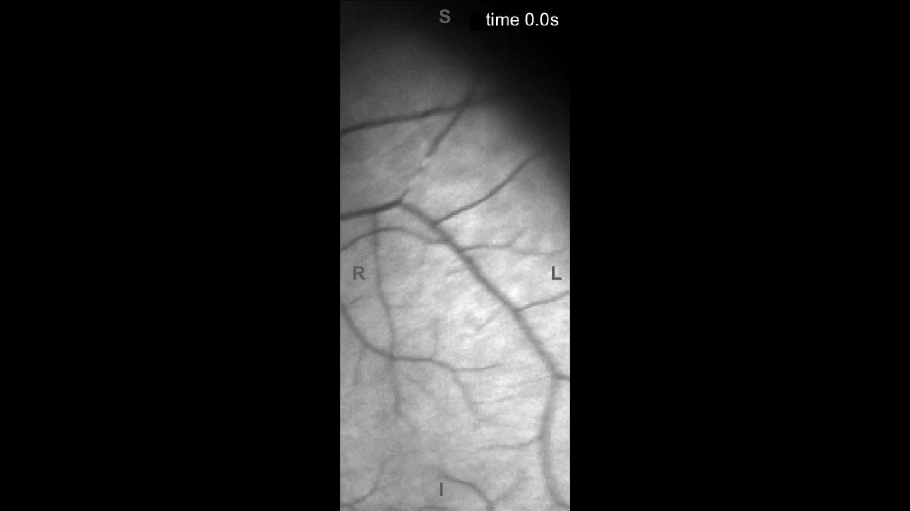
Imaging
Microemboli passing through the superior temporal branch of the central retinal artery. The video was acquired from an ocular slit lamp via hand-held cell phone camera with 20 frames per second (fps) sampling. The resampled 40-fps-video was exported twice as slow.
Non-stenotic, mixed (predominantly soft) atherosclerotic plaque (arrows) in the proximal left internal carotid artery with thin calcifications on CT-angiography sagittal (A) and axial (B) slices. Reconstructed fundus image (C) showing microemboli (encircled yellow arrow). Perimetry at 3-month follow-up corresponding to the reported scotoma (D).
Weiss et al.
Notes:
Add figure legend here

Slide 4
Diagnosis/Conclusions
Amaurosis fugax due to recurrent central retinal artery occlusion (CRAO) by microemboli
Retinal embolism from carotid artery disease is the most common cause of CRAO
Treated with intravenous thrombolysis using recombinant tissue plasminogen activator (rtPA)
Persistent partial to complete loss of vision (scotoma) in the right/nasal inferior quadrant of visual field of her left eye
Weiss et al.
Notes:
Include all references if applicable for this Teaching (Video) NeuroImage slide deck

