Slide 1
Resident & Fellow Section Teaching NeuroImage A 10-year-old girl with excessive daytime sleepiness…
Cote-Orozco JE, et al.

Slide 2
Vignette
10-year-old girl
15-day history of :
excessive daytime sleepiness,
sudden sleep onset,
hypnagogic hallucinations,
hyporexia,
behavioral changes (emotional lability).
Low hypocretin levels in cerebrospinal fluid (93 pg/dL).
Cote-Orozco JE, et al.

Slide 3
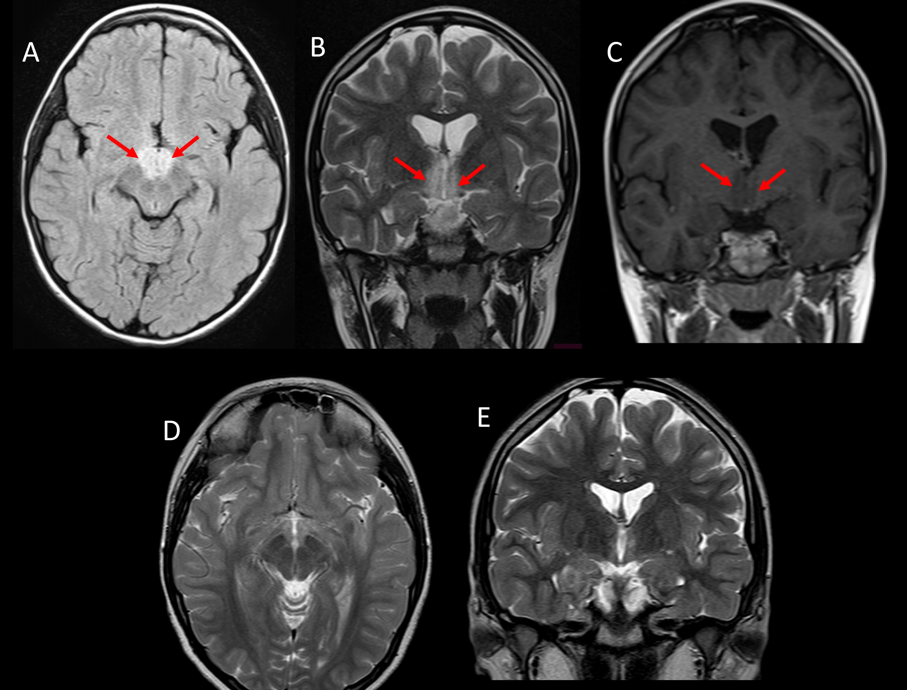
Imaging
Cote-Orozco JE, et al.
Notes:
Brain MRI after two weeks of symptoms, (A) Axial Fuid-Attenuated Inversion Recovery Imaging and (B) coronal T2-weighted image demonstrated a bilateral hypothalamic hyperintense non-enhancing (C) lesion (arrows). (D) and (E) T2-weighted images show resolution of the lesion three months after diagnosis and treatment.

Slide 4
Hypothalamic Involvement in Neuromyelitis Optica Spectrum Disorder in a Child
We found positive AQP4-IgG antibodies in serum.
A diagnosis of narcolepsy secondary to neuromyelitis optica spectrum disorder (NMOSD) was made.
She rapidly improved after glucocorticoids administration.
After 10 months of immunosuppressive maintenance therapy with azathioprine the patient remains asymptomatic.
No new lesions in follow-up neuroimages at 3 months and 9 months after diagnosis.
Any diencephalic clinical syndrome, such as narcolepsy, with hypothalamic involvement should prompt a serum test for AQP4-IgG (1,2).
Cote-Orozco JE, et al.
Notes:
References
1. Tenembaum S, Yeh EA. Pediatric NMOSD: A Review and Position Statement on Approach to Work-Up and Diagnosis. Front Pediatr. 2020 Jun 25;8.
2. Paolilo RB, Hacohen Y, Yazbeck E, Armangue T, Bruijstens A, Lechner C, et al. Treatment and outcome of aquaporin-4 antibody-positive NMOSD: A multinational pediatric study. Neurol Neuroimmunol neuroinflammation. 2020 Sep 1;7(5).

