Slide 1

Resident & Fellow Section Teaching NeuroImage 41-year-old woman with altered mental status
Lalla et al.

Slide 2
Vignette
41-year-old woman admitted with SARS-CoV-2 respiratory failure developed altered mental status.
EEG and CSF were unrevealing. MRI showed FLAIR hyperintensities in the corpus callosum and periventricular white matter.
She was treated with plasmapheresis but eventually succumbed to cardiopulmonary arrest.
Post-mortem histology revealed irregular zones of demyelination with relative axonal sparing and perivascular inflammation.
Lalla et al.

Slide 3
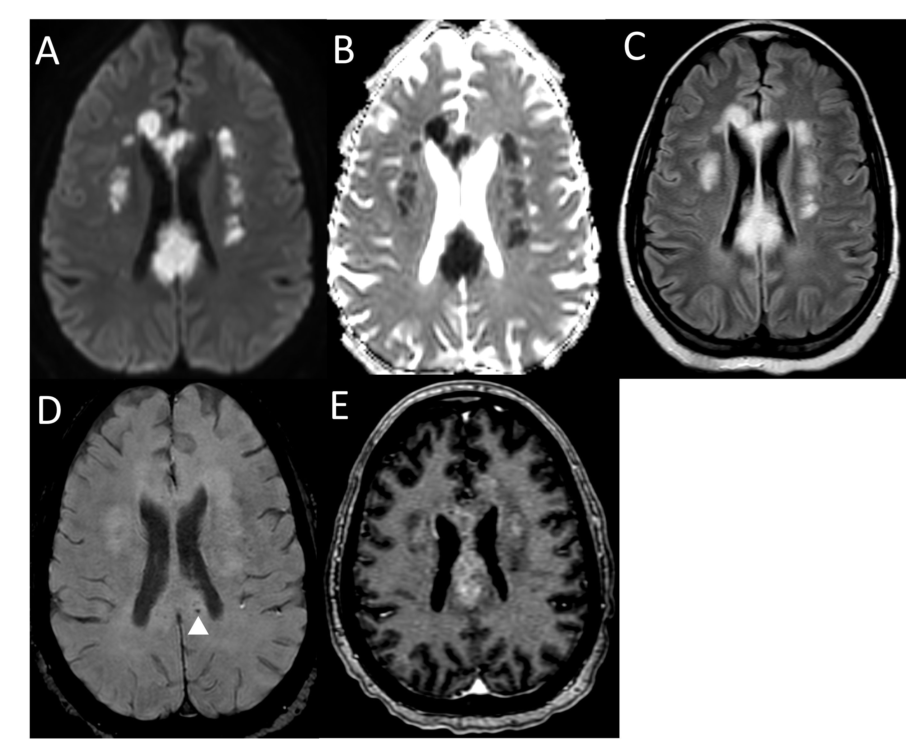
Imaging
Insert imaging here IF VIDEO NEUROIMAGE, EMBED VIDEO (NOT SCREENSHOT)
Lalla et al.
Notes:
Figure 1: MRI brain with contrast:
Diffusion weighted image (A) with Apparent Diffusion Coefficient (ADC) maps (B) showing confluent areas of restricted diffusion with associated FLAIR hyperintensity (C) involving the corpus callosum, and the bilateral corona radiata. There are a few scattered punctate foci of susceptibility artifacts (D) in the corpus callosum denoting microhemorrhages (white arrow head). Post contrast T1 weighted images (E) showing heterogeneous enhancement in the corpus callosum and corona radiata.

Slide 4
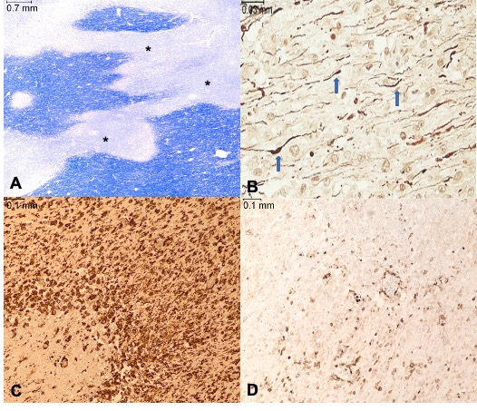
Imaging
Insert imaging here IF VIDEO NEUROIMAGE, EMBED VIDEO (NOT SCREENSHOT)
Lalla et al.
Notes:
Figure 2: Post mortem histology from the splenium of the corpus callosum.
(A): Areas of pallor representing demyelination (*) on Luxol Fast Blue histochemical stain
(B): Relative preservation of axons in demyelinated area (blue arrows) as shown by neurofilament immunohistochemical stain
(C): Dense macrophage infiltration as evidenced by CD163 immunohistochemical stain
(D): Scattered lymphocytic infiltration as demonstrated by leukocyte common antigen immunohistochemical stain

Slide 5
Imaging and pathology in COVID ADEM
SARS-CoV-2 related ADEM can be difficult to diagnose clinically.
Involvement of the deep white matter and corpus callosum has been previously reported, as well as hemorrhagic leukoencephalopathy, though only minimal microhemorrhage was present for this patient.
Outcomes of SARS-CoV-2 related ADEM are often poor.
Lalla et al.
Notes:
References
1. Reichard RR, Kashani KB, Boire NA, Constantopoulos E, Guo Y, Lucchinetti CF. Neuropathology of COVID-19: a spectrum of vascular and acute disseminated encephalomyelitis (ADEM)-like pathology. Acta Neuropathol. 2020;140(1):1-6. doi:10.1007/s00401-020-02166-2
2. Wang Y, Wang Y, Huo L, Li Q, Chen J, Wang H. SARS-CoV-2-associated acute disseminated encephalomyelitis: a systematic review of the literature. J Neurol. 2022;269(3):1071-1092. doi:10.1007/s00415-021-10771-8

