Slide 1

Resident & Fellow Section Teaching Video NeuroImage A 5-year-old boy with inability to move his eyes to the sides.
Thabet et al.

Slide 2
Vignette
A 5-year-old normally developing child.
He presented with a 4-week history of inability to move his eyes side to side. Instead, he moves his head to follow objects.
His neurological examination was normal except for inability to move his eyes horizontally.
No other focal neurological findings.
Thabet et al.

Slide 3
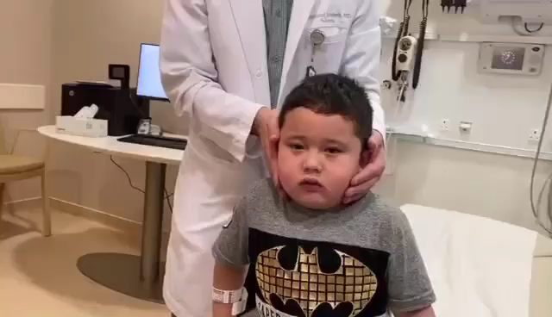
Video NeuroImaging
Thabet et al.
Notes:
Video 1: Oculomotor apraxia with inability to move the eyes horizontally. The patient is shown turning his head to the object to compensate.

Slide 4
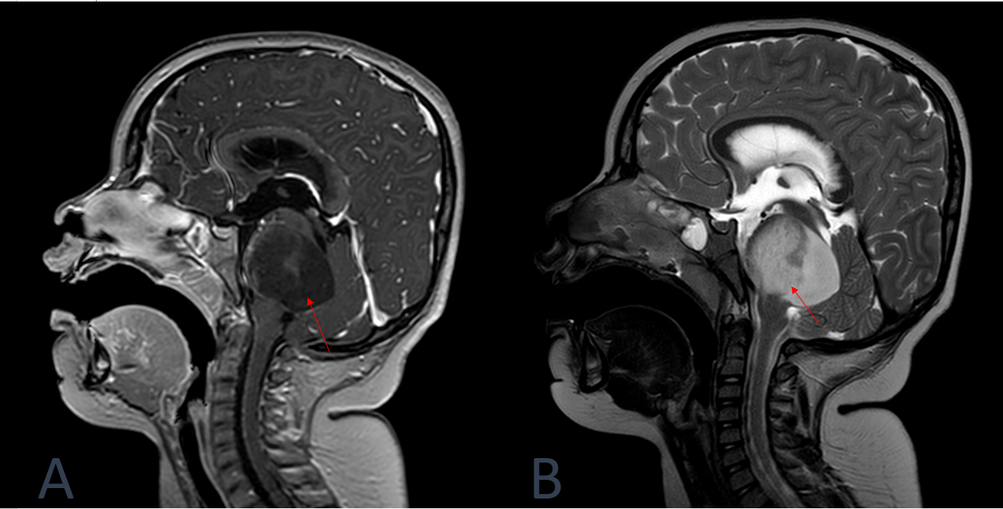
NeuroImaging
Thabet et al.
Notes:
Figure: Brain MRI T1-weighted image (sagittal view) showing a mass centered in the pons (arrow) with significant expansion and mild extension to the midbrain as well as a posterior exophytic component obliterating the 4th ventricle leading to early hydrocephalus (A). T2-weighted image showing high signal intensity of the tumor (B).
Please provide a brief title for the Figure.

Slide 5
Diagnosis/conclusions Oculomotor Apraxia as the only presentation of diffuse intrinsic pontine glioma.
Examination is consistent with oculomotor apraxia.
Brain MRI showed diffuse intrinsic pontine glioma (DIPG) with early hydrocephalus.
The patient required a ventriculoperitoneal shunt placement and radiotherapy.
DIPG is an aggressive pediatric tumor which typically presents with cranial nerve palsies, long tract signs and ataxia.
The brainstem tumor has disrupted the structural connectivity between the frontal eye field and oculomotor network including the pons, the superior colliculs and caudate nucleus leading to oculomotor apraxia.
Thabet et al.
Notes:
Include all references if applicable for this Teaching (Video) NeuroImage slide deck

