Slide 1

Resident & Fellow Section Teaching NeuroImage A 61-year-old male with positional headache and weight loss
Andrew Silverman et al.

Slide 2
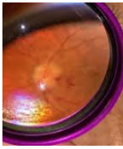
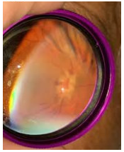
Vignette
PMHx includes 47 pack-year smoking history
Presented with positional headache, worse supine
Review of systems positive for early satiety and weight loss
Neurological exam showed bilateral grade 4 papilledema (otherwise unremarkable)
Skin exam revealed concurrent eruption of multiple papules and nodules on the patient’s chest, shoulder, and back
Lumbar puncture revealed elevated CSF opening pressure and signet-ring carcinoma cells via cytology (glucose 27 mg/dL, protein 48 mg/dL, 5 RBCs, 8 WBCs)
Skin and gastric biopsies were consistent with metastatic primary gastric cell adenocarcinoma
OD
OS
Andrew Silverman et al.

Slide 3
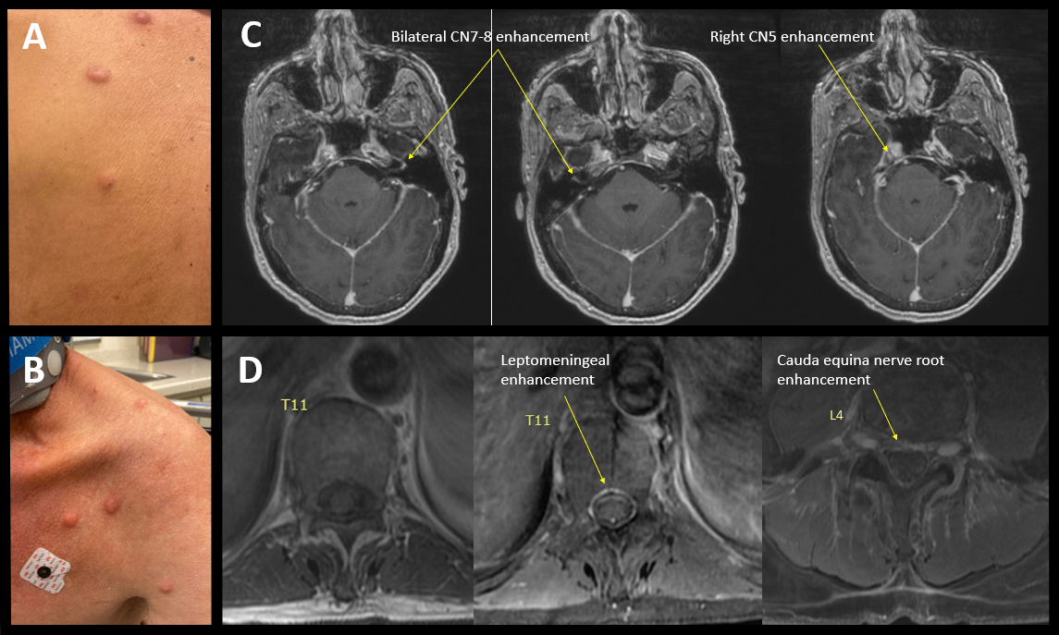
Imaging
Andrew Silverman et al.
Notes:
Extended Figure: Examination and imaging findings. Pink and violaceous papules and nodules on the (A) back and (B) chest and shoulder. Axial T1 post-contrast MRI brain sequences showing: (C) linear enhancement of bilateral facial and vestibulocochlear nerve complexes; enhancement of the right trigeminal nerve in Meckel's cave; and (D) pre- and post-contrast axial T1 sequences highlighting patchy spinal leptomeningeal as well as cauda equina nerve root enhancement, cumulatively concerning for leptomeningeal disease.

Slide 4
Cutaneous lesions and leptomeningeal carcinomatosis in gastric signet-ring cell carcinoma
Overall, cutaneous metastases manifest in 0.6%-10.4% of all patients with cancer, and leptomeningeal disease (LMD) is diagnosed in approximately 5% of patients with metastatic malignancies. [1,2]
Leptomeningeal carcinomatosis is rare and occurs in only 0.14-0.24% of all gastric carcinomas. [3,4]
To our knowledge, cutaneous involvement with LMD related to gastric cancer has not been reported in the literature.
This case highlights the relevance of a general exam and consideration of comorbidities in approaching an unclear neurological presentation, particularly when considering possible leptomeningeal disease.
Andrew Silverman et al.
Notes:
References:
1) Alcaraz I, Cerroni L, Rütten A, Kutzner H, Requena L. Cutaneous metastases from internal malignancies: a clinicopathologic and immunohistochemical review. Am J Dermatopathol. 2012 Jun;34(4):347-93. doi: 10.1097/DAD.0b013e31823069cf. PMID: 22617133.
2) Demopoulos A. Clinical features and diagnosis of leptomeningeal disease from solid tumors. Post TW, ed. UpToDate, Waltham, MA: UpToDate, Inc. (Lasted updated May 24, 2022).
3) Guo JW, Zhang XT, Chen XS, Zhang XC, Zheng GJ, Zhang BP, Cai YF. Leptomeningeal carcinomatosis as the initial manifestation of gastric adenocarcinoma: a case report. World J Gastroenterol. 2014 Feb 28;20(8):2120-6.
4) Ali S, Khan MT, Idrisov EA, Maqsood A, Asad-Ur-Rahman F, Abusaada K. Signet Cell in the Brain: A Case Report of Leptomeningeal Carcinomatosis as the Presenting Feature of Gastric Signet Cell Cancer. Cureus. 2017 Mar 7;9(3):e1085.

