Slide 1

Resident & Fellow Section Teaching Video NeuroImage A 23-year-old female with abnormal eye movements after stroke
Jacky Ganguly et al.

Slide 2
Vignette
A 23-year-old healthy female
Spontaneous eye movements started within 3 days of acute stroke
No past medical history
On examination, horizontal gaze palsy noted apart from the spontaneous eye movements
Jacky Ganguly et al.

Slide 3
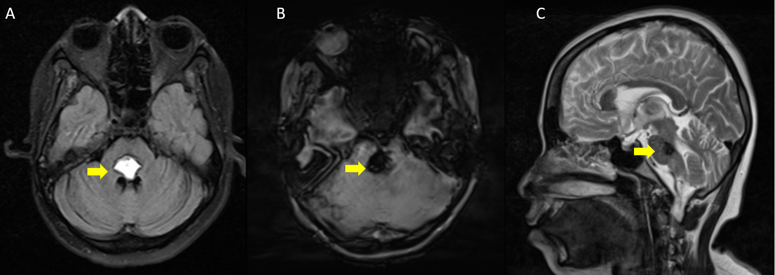
Imaging and Video
Click here to access the Video online
Jacky Ganguly et al.
Notes:
Figure 1. Axial T2FLAIR MRI (A) showing acute haemorrhage at dorsal pons with blooming in SWI (B) and follow-up sagittal T2 MRI (C) image showing haemorrhagic residue. Arrows indicate the site of haemorrhage.
Video 1. Continuous pendular vertical oscillations in primary gaze along with bilateral horizontal gaze palsy.

Slide 4
Pendular Vertical Oscillations (PVOs)
Rare phenomenon after pontine stroke
Initially described as ‘ocular myoclonus’
Pathophysiology of PVOs include: (1) synchronized neural oscillations from the inferior olive following disruption of the central tegmental tract, (2) unstable integration of vertical gaze in the interstitial nucleus of Cajal from damage to the pontine paramedian tract or (3) injury to omnipause neurons
Differential diagnosis: ocular bobbing and oculopalatal tremor
Jacky Ganguly et al.
Notes:
References
1. Chang TP, Gold DR, Otero-Millan J, Huang BR, Zee DS. Pendular Oscillation and Ocular Bobbing After Pontine Hemorrhage. The Cerebellum. 2021;20(5):734-743. doi:10.1007/s12311-019-01086-6
2. Borruat FX. Oculopalatal tremor. Curr Opin Neurol. 2013;26(1):67-73. doi:10.1097/WCO.0b013e32835c60e6

