Slide 1

Resident & Fellow Section Teaching NeuroImage 48-year-old male with cervical cord injury and arm weakness
Rotter et al.

Slide 2
Vignette
46-year-old male with spinal cord injury resulting in C5 tetraparesis and partially functioning C5-7 myotomes
2 years later, olfactory stem cell injection into cervical post-traumatic syrinx led to progressive loss of upper extremity function
C5 syringo-subarachnoid shunt placement did not improve his strength
Syrinx exploration revealed pockets of white gelatinous exudate
Pathologic review of exudate revealed respiratory epithelium and seromucinous glands within fibrous stroma
Patient regained upper extremity function within 4 months
Rotter et al.

Slide 3
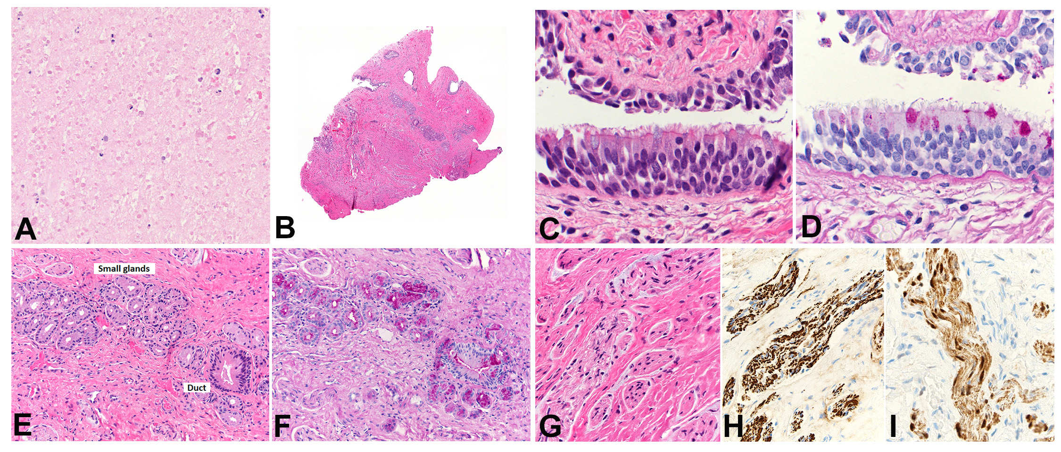
Imaging
Rotter et al.
Notes:
Figure 1: MRI and Intraoperative Photographs (A) Preoperative and (B) postoperative sagittal MRI with arrows highlighting complex syrinx. Intraoperative photograph of (C) syrinx cavity and (D) mucinous syrinx material.
Figure 2: Pathology of the Lesion (A) Amor-phous nasal secretion x200; (B) cyst wall highlighting ciliated respiratory mucosa in upper left box, small sero-mucinous gland in upper right box, small nerve twigs in lower right box; (C) H&E x400, (D) PAS of ciliated res-piratory mucosa with goblet cells x400; (E) H&E x200, (F) PAS showing small seromucinous gland, duct x200; (G) S100 showing small nerve twigs in dense fibrous tissue with axons, Schwann cells x400; (H) neurofilament x400; (I) S100 showing Schwann cells x400.

Slide 4
Cervical syrinx with actively secreting respiratory mucosa
Olfactory stem cells are an experimental treatment to improve function after traumatic spinal cord injury
Mesenchymal stromal cell injection in the syrinx can reduce size and improve function
Side effects are possible and patient should be carefully monitored following this procedure
Rotter et al.
Notes:
Zamani H, Soufizomorrod M, Oraee-Yazdani S, Naviafar D, et al. Safety and feasibility of autologous olfactory ensheathing cell and bone marrow mesenchymal stem cell co-transplantation in chronic human spinal cord injury: A clinical trial. Spinal Cord 2022;60:63-70.
Vaquero J, Hassan R, Fernández C, et al. Cell therapy as a new approach to the treatment of posttraumatic syringomyelia. World Neurosurgery 2017;107:1047-e5.

