Slide 1
Resident & Fellow Section Teaching NeuroImage A 14-year-old girl with episodic abdominal pain.
Basovic et al.

Slide 2
Vignette
A 14 year-old right-handed female presented to the epilepsy monitoring unit for diagnostic evaluation of recurrent episodes of abdominal pain.
She had multiple typical episodes during the admission without ictal correlate and was ultimately diagnosed with non-epileptic events.
Basovic et al.

Slide 3
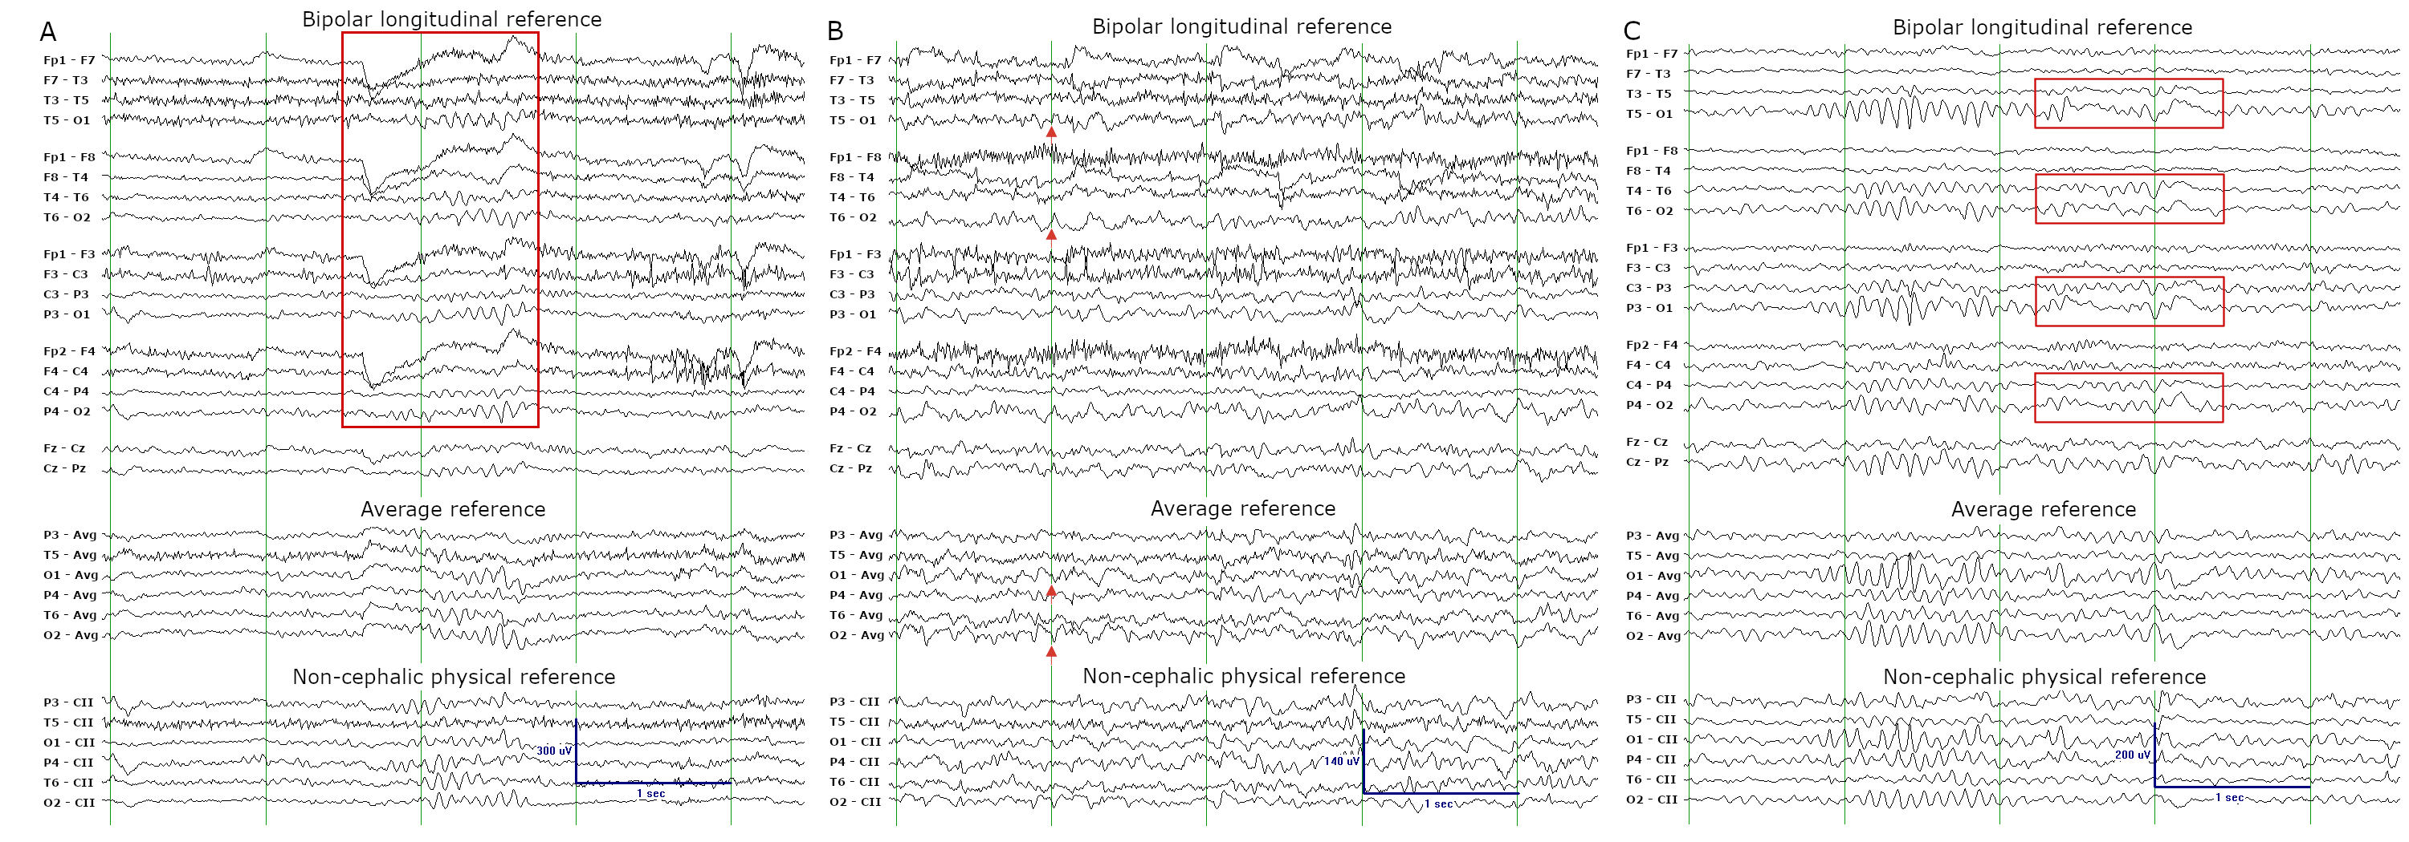
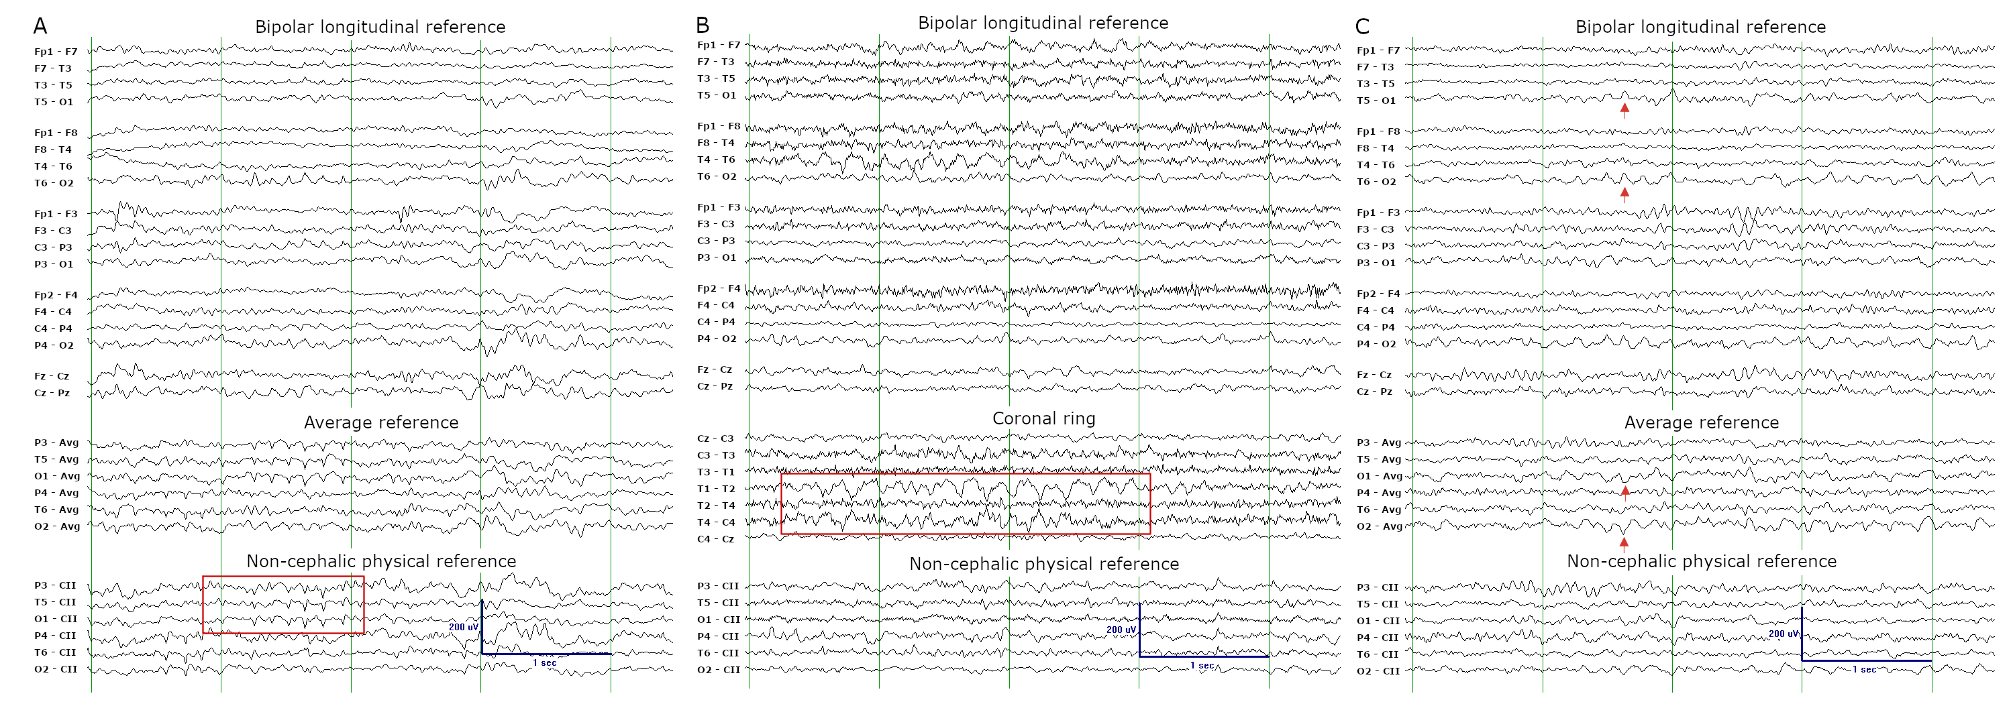
Imaging
Basovic et al.
Notes:
Figure 1. Normal variants during the wake EEG. (A) the alpha squeak is a fast posterior dominant rhythm evident during eye blinks; (B) lambda waves are positive occipital sharp waves present during visual scanning of high-contrast environments; (C) posterior slow waves of youth are delta waves embedded within the posterior dominant rhythm.
Figure 2. Normal variants during the drowsy and sleep EEG. (A) 14 & 6 Hz positive spikes are 1-2 second bursts of spiky, arciform waveforms; (B) rhythmic mid-temporal theta of drowsiness, or psychomotor variant, consists of non-evolving runs of prominent theta activity; (C) positive occipital sharp transients of sleep are morphologically similar to lambda waves.

Slide 4
Pictures of health in pediatric EEG
However, her long-term EEG recording revealed several transient findings during wakefulness and sleep that were each consistent with normal developmental EEG variants.
We show examples of these key variants in three separate montages, highlighting the montage(s) in which each is best appreciated^{1,2}.
Proper recognition of these age-appropriate normal variants in EEG is key to avoid overinterpretation and misdiagnosis².
Basovic et al.
Notes:
References 1. Ebersole JS, Husain AM, Nordli DR. Current Practice of Clinical Electroencephalography. Wolters Kluwer Health; 2015.
2. Stern JM, Engel J. Atlas of EEG Patterns. Wolters Kluwer/Lippincott Williams & Wilkins

